Slide 1

Tablet test launch

Slide 2
After a great deal of effort we have successfully test launch the tablet in two different locations.
The results of the first trial have exceeded our expectations in some aspects and fall sort in others
In this presentation we will try to make the most of these results
Summary

Slide 3
The customer survey tried to answer the following questions:
-Did the customers enjoy using the tablet?
-Have the customers find easy using the tablets?
-Are the customers confident paying using the tablet?
-Will the customers prefer using the tablets on their next visit?
-Have the tablets fulfilled their original purpose of cutting down the average waiting time?
-Have the tablets reduced the sitting time of every table?
Overview

Slide 4
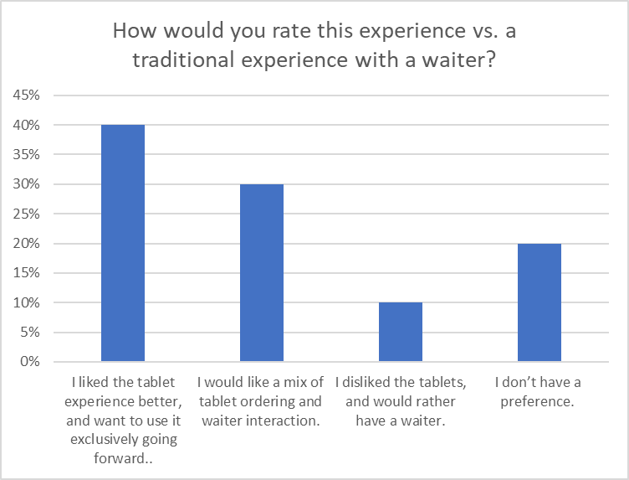
One of the most significant finding
is presented in the next diagramme.
40% of the customers liked the tablets
and 30% of them said that they would
prefer a mix of tablet ordering and waiter
interaction. Only 10% of the users disliked
the tablets and said the would prefer
the waiter.
Findings

Slide 5
First and foremost we should address the technical issues tha occurred during the launching phase. This includes,but is not limited to:
- The screen froze
- It was glitchy
- It kept freezing but after the waiter did a reboot it was fine
- It froze up a couple times
Next Steps

Slide 6
-We should have the option of a “hybrid model” to accommodate customers who are ok with ordering using the tablet but do not feel confident paying with it and require the presence of a waiter.
-People should be given the choice of selecting among:
1)only using the tablet
2)having the hybrid model
3)having a waiter
Next Steps

